Slide 1
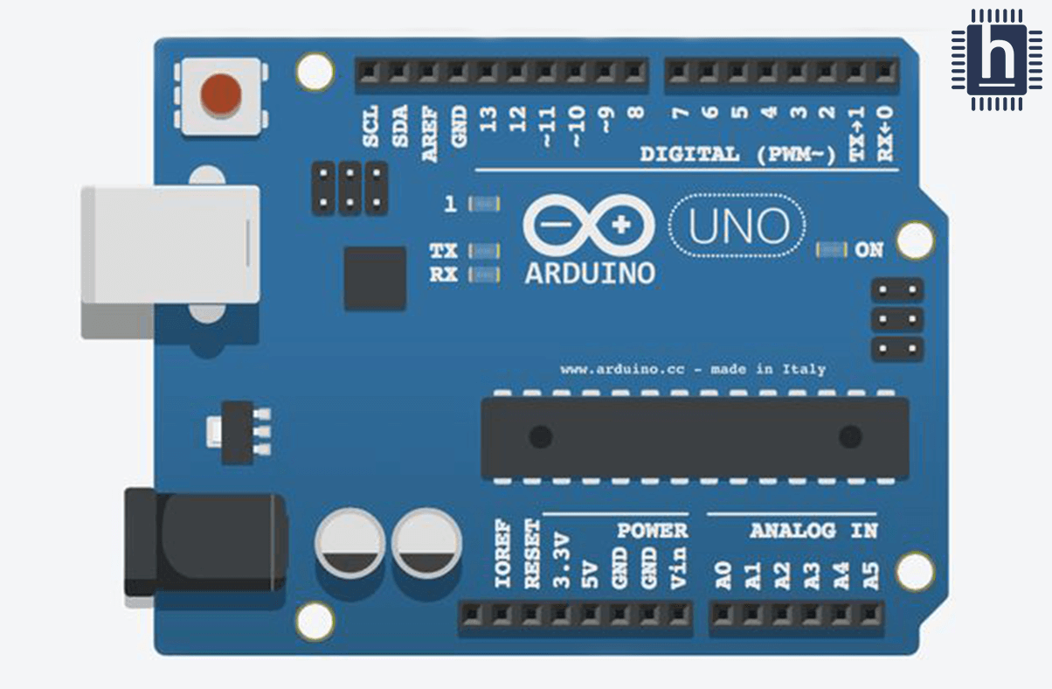
Vibration Sensor
GSM
Tx
Rx
GPS
Tx
Rx

